Slide 1

Identifying Triggers
& Coping Interventions
Mental Health Group Teaching Session
Goal: identify personal triggers, warning signs, and safe coping skills to decrease symptoms and support recovery.
Group opener included
Crisis-unit friendly
Facilitator tone
Supportive, practical, nonjudgmental. Participation can be verbal, written, or silent.
Notes:
[Sources]
Visual on this slide was generated with Microsoft Copilot.

Slide 2
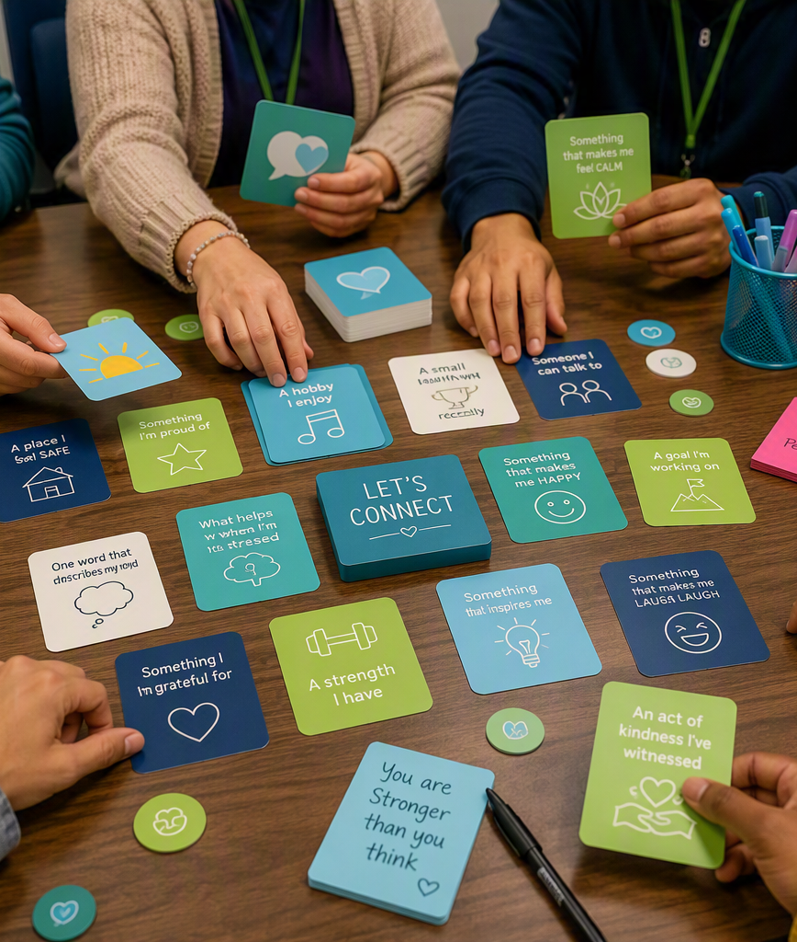
Fun Opening Activity: “Trigger Toss + Coping Match”
A safe, low-pressure way to warm up the group and introduce the topic
How it works
Keep it fun + safe
1. Place trigger cards and coping cards face-down.
2. Client picks one trigger card.
3. Client names or chooses one coping skill that could help.
4. Client may pass, point, or ask the group for ideas.
Use simple examples: loud noise, poor sleep, cravings, conflict, boredom, feeling overwhelmed. Avoid asking clients to share trauma details. Praise participation and choice.
Quick materials
Debrief question
Index cards, sticky notes, markers, small soft ball or beanbag, and a whiteboard. If no supplies are available, use verbal prompts.
“What coping skill could you realistically try on the unit today?”
Suggested time: 5-7 minutes
Notes:
[Sources]
Activity format is a facilitator suggestion created for this deck. Visual on this slide was generated with Microsoft Copilot.

Slide 3
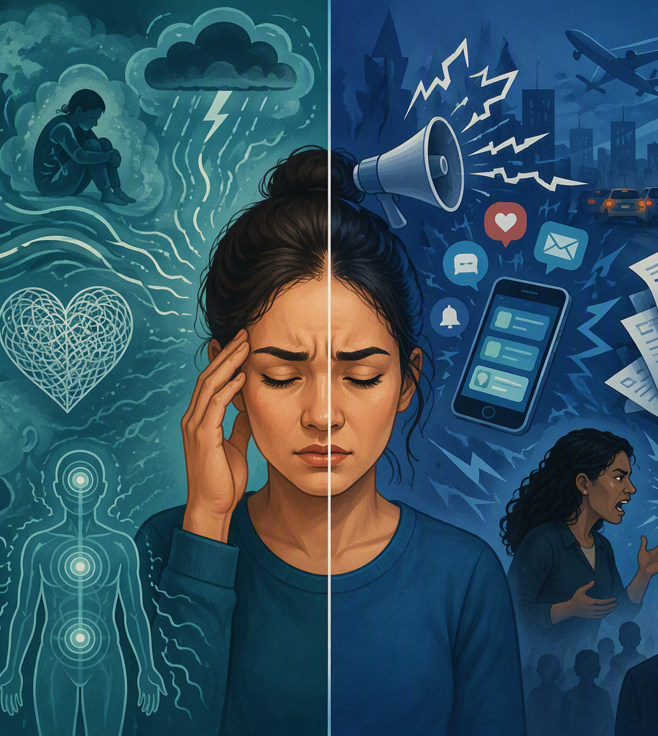
What Are Triggers?
Triggers can come from inside the body/mind or from the environment
Internal triggers
External triggers
Thoughts, memories, pain, poor sleep, hunger, anxiety, depression, shame, loneliness, racing thoughts, cravings, or withdrawal discomfort.
Conflict, loud noise, crowded spaces, bills, family stress, substance cues, phone calls, relationship issues, or feeling judged.
Why identify triggers?
Early awareness helps the client pause, ask for help, choose a coping skill, and reduce the chance of symptoms escalating.
Teaching point: Triggers do not mean failure. Triggers are information.
Notes:
[Sources]
NAMI lists common warning signs such as excessive worry/fear, feeling sad or low, confused thinking, concentration problems, extreme mood changes, irritability/anger, withdrawal from social activities, sleep/eating changes, hallucinations/delusions, substance overuse, suicidal thinking, and difficulty handling daily stress. https://www.nami.org/warning-signs-and-symptoms/
Visual on this slide was generated with Microsoft Copilot.

Slide 4
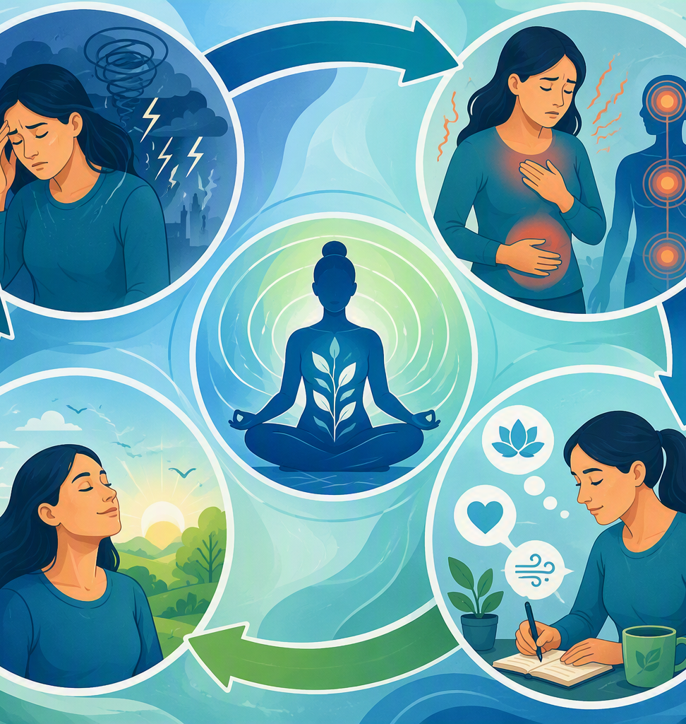
The Trigger-to-Symptom Cycle
Coping skills interrupt the cycle before symptoms become unsafe or overwhelming
1
Trigger
Something happens inside or outside the person.
2
Body + thoughts react
Heart races, stomach tightens, thoughts speed up, cravings increase.
3
Coping intervention
Pause, breathe, ground, talk with staff, journal, move safely, request PRN if ordered.
4
Result
The body settles, thinking becomes clearer, and choices feel more manageable.
Notes:
[Sources]
SAMHSA suggests coping approaches such as deep breathing, writing/drawing feelings, regular routines, sleep, movement/stretching, and connecting with support. https://www.samhsa.gov/find-support/how-to-cope
Visual on this slide was generated with Microsoft Copilot.

Slide 5
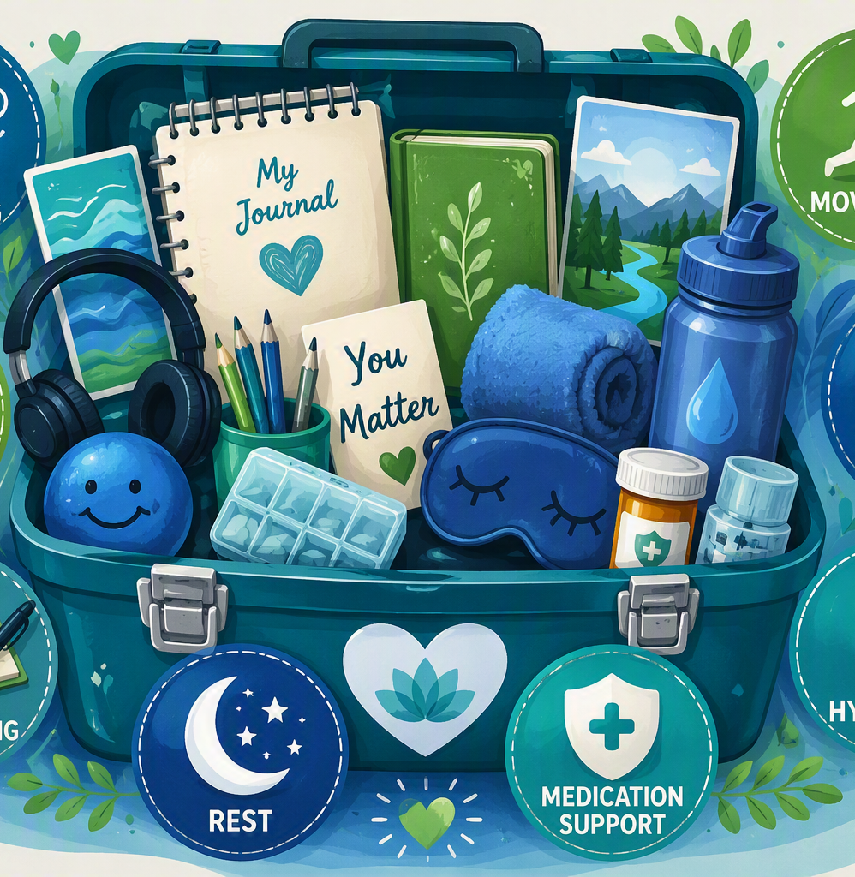
Coping Intervention Toolbox
Clients can try more than one skill and repeat the skills that work
Deep breathing
Grounding
Slows the body and supports calmer choices.
Brings attention back to the present moment.
Talking with staff
Journaling or art
Adds support before symptoms escalate.
Helps name thoughts, feelings, and triggers.
Safe movement
Hydration + nutrition
Uses energy and reduces restlessness.
Supports basic body needs during stress.
Rest or quiet time
Reduces stimulation and supports recovery.
Notes:
[Sources]
SAMHSA suggests taking deep breaths, writing or drawing feelings, getting enough sleep, stretching/walking/exercise, regular schedules, and connecting with supportive people. https://www.samhsa.gov/find-support/how-to-cope
Visual on this slide was generated with Microsoft Copilot.

Slide 6
Match the Symptom to an Intervention
Choose coping skills based on what the body and mind are doing
When the client notices...
Try this intervention...
RN teaching language
High anxiety or panic feelings
Deep breathing + grounding
“Slow the body first, then choose the next safe step.”
Anger, irritation, restlessness
Take space, walk appropriately, reduce stimulation
“Pause before reacting. Ask staff for support early.”
Cravings or withdrawal discomfort
Hydrate, snack, distraction, talk with staff, PRN if ordered
“Cravings rise and fall. Report worsening symptoms.”
Depression or isolation
Small goal, hygiene, group, talk with staff
“One small action can help restart the day.”
AH/VH, paranoia, or racing thoughts
Stay visible, grounding, low stimulation, medication support
“Report unsafe thoughts or worsening symptoms immediately.”
Facilitator reminder: Ask “What is one skill you can use before symptoms get to a 10/10?”
Notes:
[Sources]
SAMHSA suggests coping approaches including deep breathing, writing/drawing feelings, sleep, movement/stretching, routines, and supportive connection. https://www.samhsa.gov/find-support/how-to-cope
Table content includes facilitator suggestions created for this deck.

Slide 7
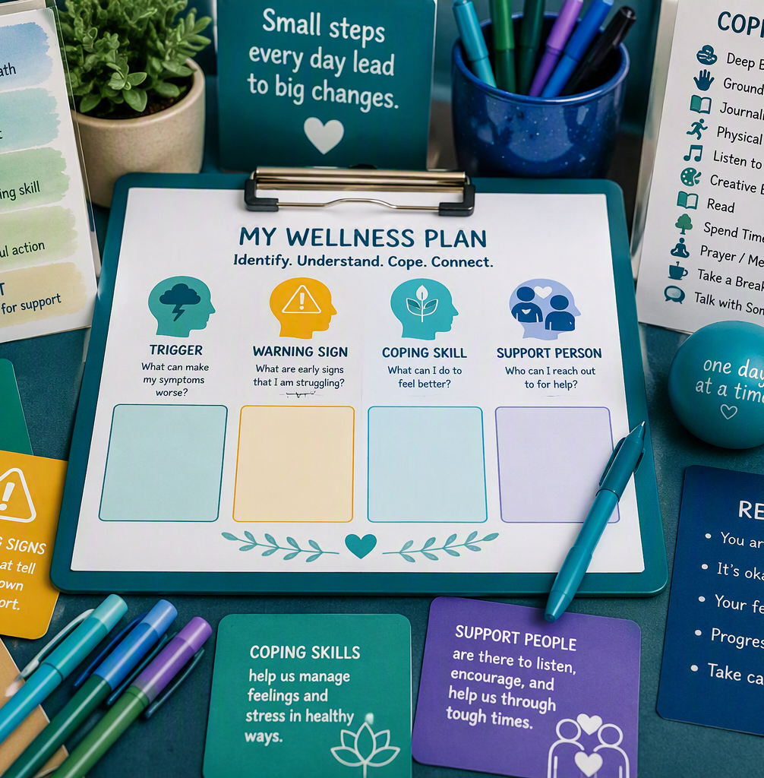
Build a Personal Coping Plan
A simple worksheet activity to turn group education into a practical plan
Step 1: Identify a trigger
“What tends to make symptoms, cravings, or unsafe thoughts worse?”
Step 2: Name a warning sign
“How does the body or behavior show that stress is building?”
Step 3: Pick one coping skill
“What is one safe action that can be used on the unit today?”
Step 4: Ask for support
“Who can the client tell before symptoms become unsafe or overwhelming?”
Notes:
[Sources]
SAMHSA encourages connecting with people for support and using coping steps such as deep breathing, writing/drawing feelings, sleep, movement/stretching, and regular routines. https://www.samhsa.gov/find-support/how-to-cope
Visual on this slide was generated with Microsoft Copilot.

Slide 8

Close the Group
Three takeaways
1
Triggers are information, not failure.
2
Coping skills work best when practiced early.
3
Ask for help before symptoms feel unsafe.
Safety reminder
Notify staff immediately for SI/HI, AH/VH, command hallucinations, cravings, withdrawal symptoms, medication side effects, or feeling unable to stay safe.
Call or text 988 if in crisis
Notes:
[Sources]
SAMHSA states that if someone is struggling or in crisis, they can call or text 988 or chat 988lifeline.org. https://www.samhsa.gov/find-support/how-to-cope
Visual on this slide was generated with Microsoft Copilot.

